Slide 1
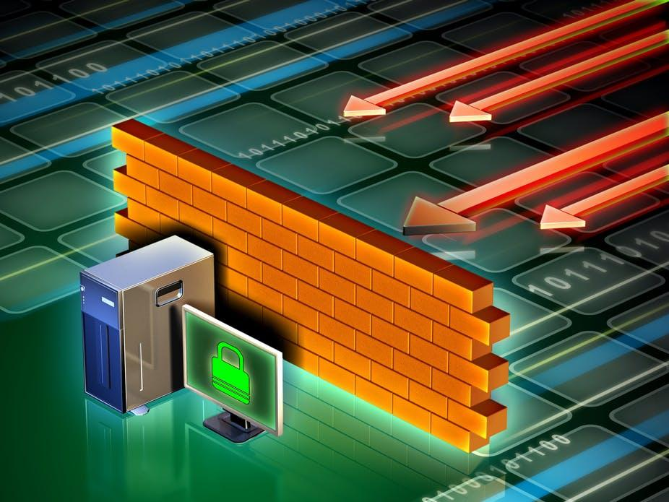
Project Exhibition-1 Review-1 Concept-Packet Filtering Firewall

Slide 2
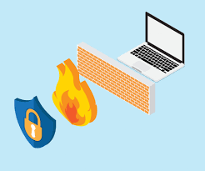
Abstract
A firewall is a tool, that is used to filter out data packets, passing through a network. It can be a software, hardware or combination of both.
It is the barrier between a unsecure network and a secure one.
Usually acts as the first line of defense, in case a network gets attacked.
Criteria for filtering-Based on some predefined rules set by the network admin.

Slide 3
Existing Work: Generation of Firewalls
First Generation : Packet Filtering Firewalls
The first firewall proposal, or packet filter, came in 1989 by Jeff Mogul of Digital Equipment Corporation. Packet filters act by inspecting the "packets" which transfer between computers on the Internet.
Second Generation : Circuit Level Firewalls
Dave Presetto, Janardan Sharma, and Kshitij Nigam, of AT&T bell laboratories, developed the second generation of firewalls, dubbing them circuit level firewalls. These circuit level firewalls are simply an upgraded version of the first generation

Slide 4
Third Generation:
Marcus Ranum, Wei Xu, and Peter Churchyard released an application firewall known as Firewall Toolkit in 1993.
The benefit of application-layer filtering is that it can understand protocols such as File Transfer Protocol , Domain Name System, or Hypertext Transfer Protocol. This allows it to identify unwanted applications or services using a nonstandard port or detect if an allowed protocol is being abused.

Slide 5
Proposed Work
Objective-To create a packet filtering firewall prototype
Based on Linux or Windows OS (Undecided)
Single system and network implementation
Ensure efficiency of filtering
Able to manage moderate-to-heavy load of data packets, passing through it
Supported for TCP/IP and ICMP protocols
Back to basics

Slide 6
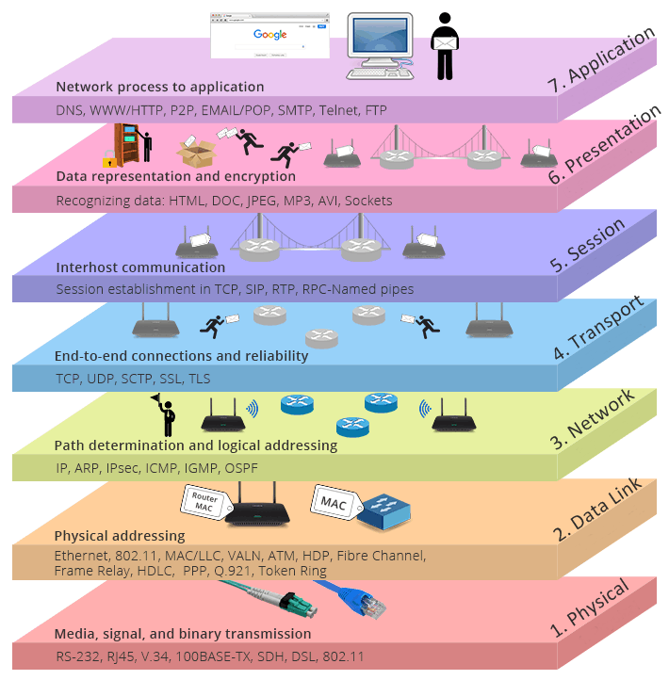
Basis of our proposed work

Slide 7
Proposed Features
Installing/Disabling a provider
Permission to block certain users and applications
Reserving Ports
Filtering Deletion
Viewing current state of firewall

Slide 8
Novelty of Work
Implementation Features
A user friendly approach/interface
Less complexity, than standard firewalls
User control over predefined rules
An efficient solution

Slide 9
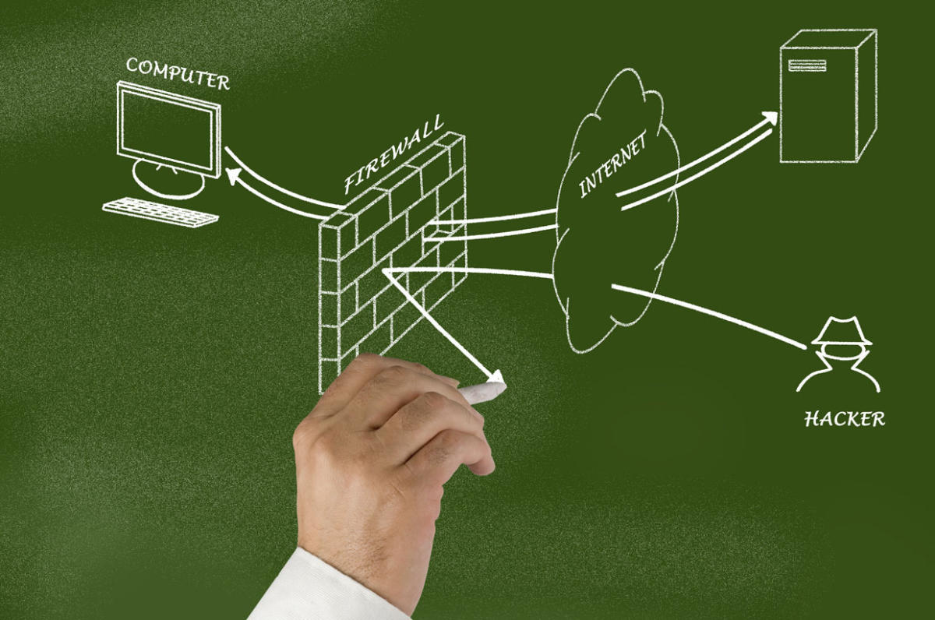
Conclusion
Through our work, we want to:-
Visit the very basics of what was Internet Security and now, Cyber Security
Implement an older, but efficient tool
Realize, what a firewall is and it's modifications,through the years

Slide 10
References
https://www.cn.edu/libraries/tiny_mce/tiny_mce/plugins/filemanager/files/Honors2011/Rogers_Terry.pdf
https://docs.microsoft.com/en-us/windows/win32/fwp/windows-filtering-platform-start-page
https://www.codeproject.com/Articles/3405/Developing-Firewalls-for-Windows-2000-XP
https://ostec.blog/en/perimeter/firewall

